Slide 1
Teamtreffen 27.06
Notes:
20.08.2023
1
1

Slide 2
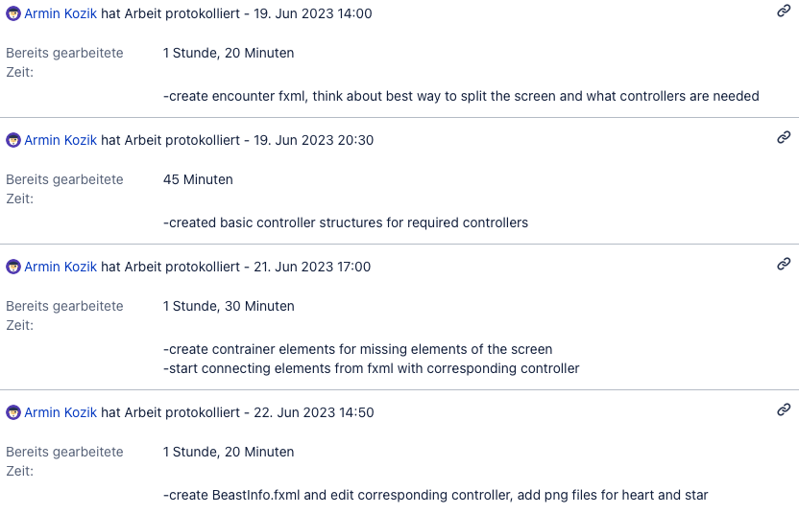
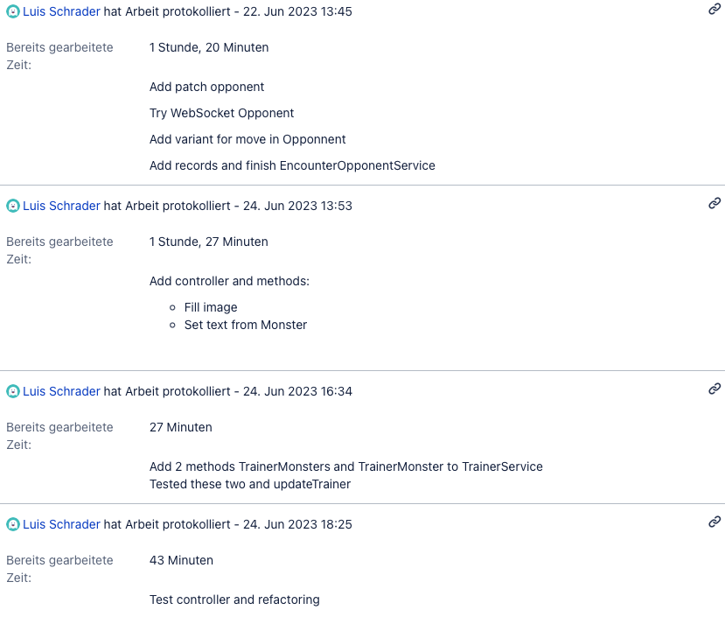
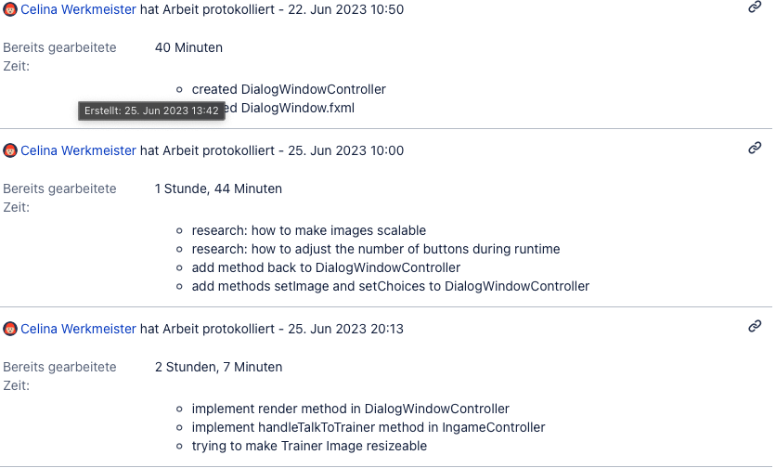
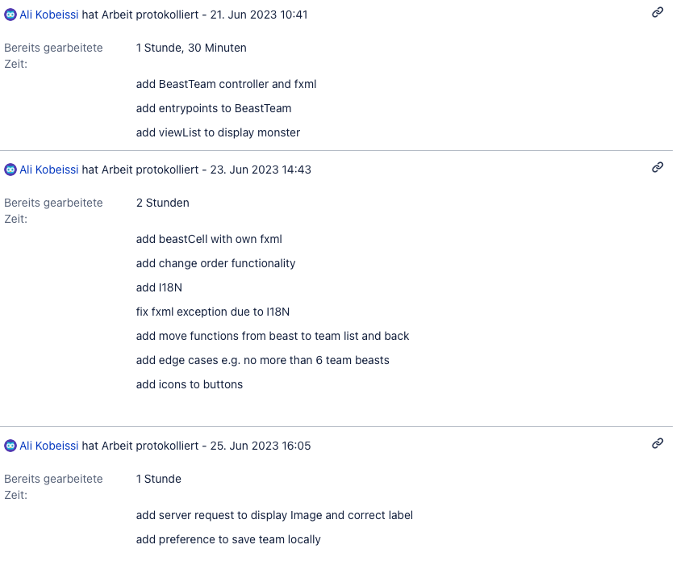
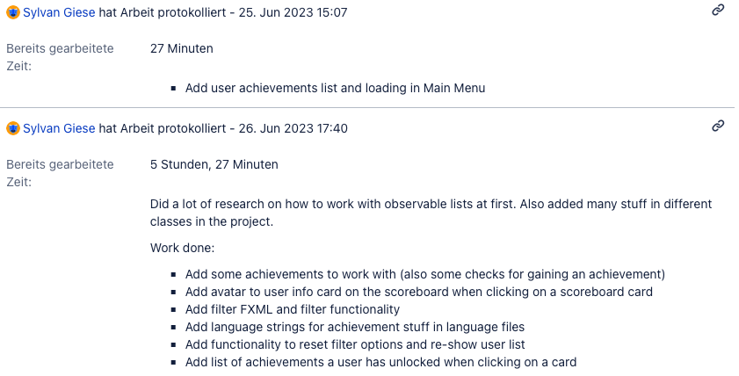
Sprint 1 v3 - Lob
Notes:
20.08.2023
2
2

Slide 3
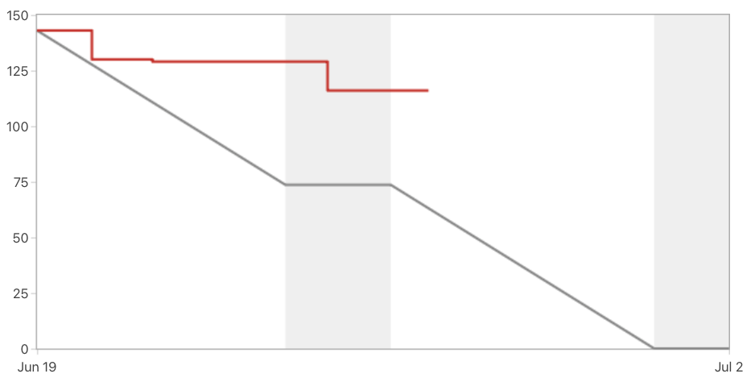

Sprint 1 v3 - Burndown
Notes:
20.08.2023
3
3

Slide 4
Sprint 1 v3 - Entwicklung
Luis: Fight-Started Screens
Celina: Dialog Overlay
Armin: Combat Screen
Ali: Beast-Team + Theme-Name + Tests Sylvan: Achievement Filter Jonas: Stories
Notes:
20.08.2023
4
4

